Slide 1
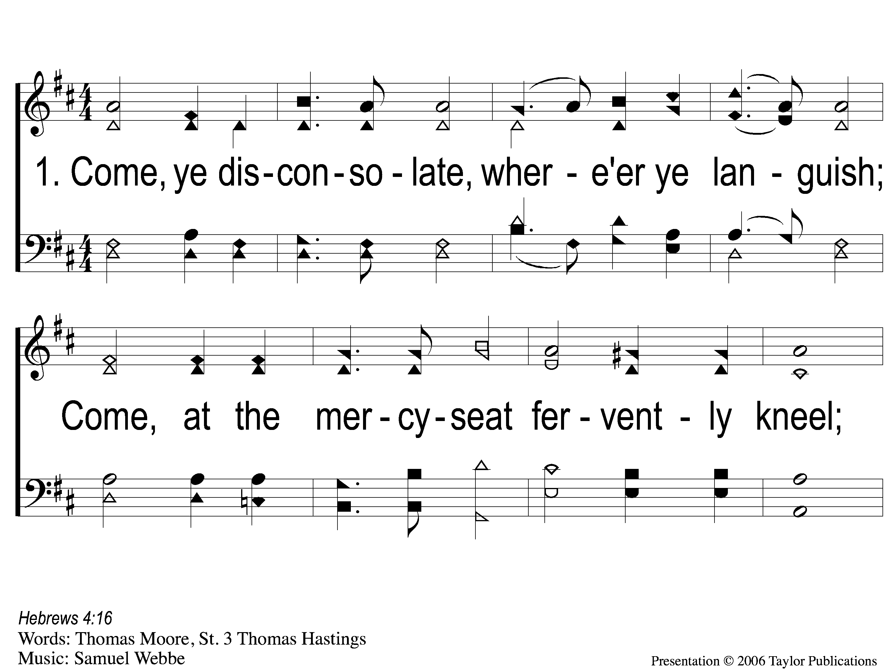
1-1 Come Ye Disconsolate
Come, Ye Disconsolate
61

Slide 2
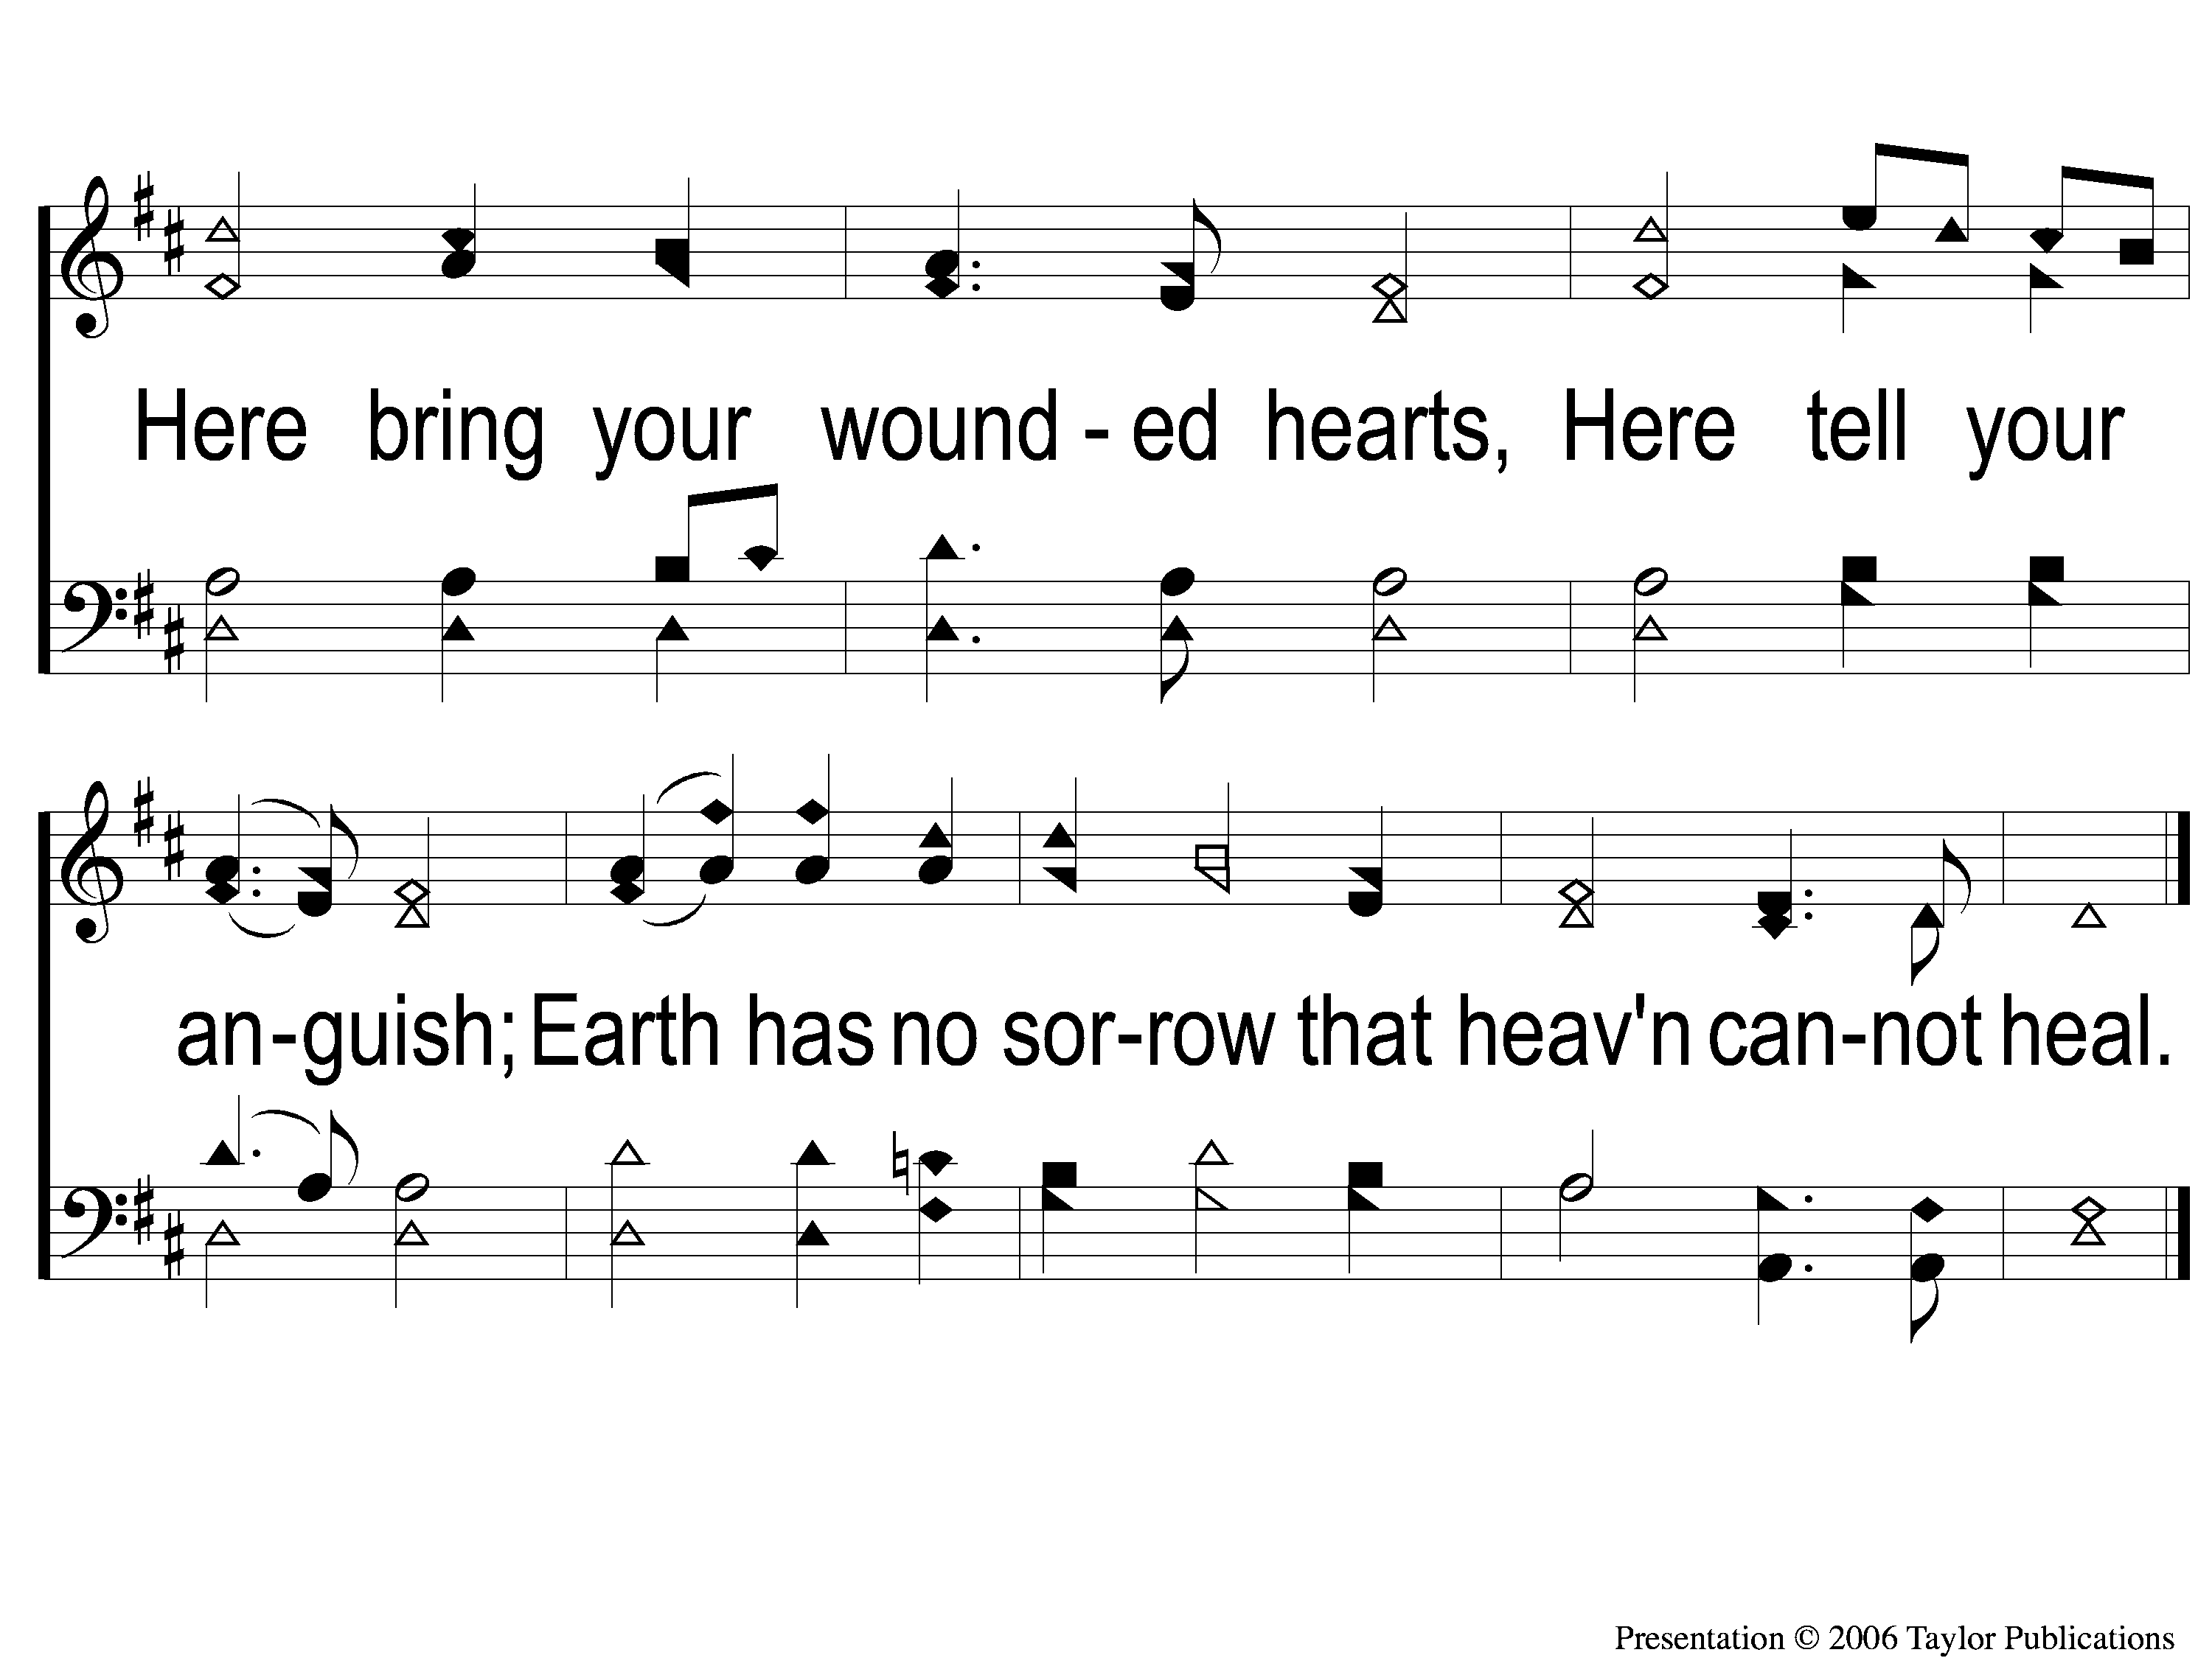
1-2 Come Ye Disconsolate
Come, Ye Disconsolate
61

Slide 3
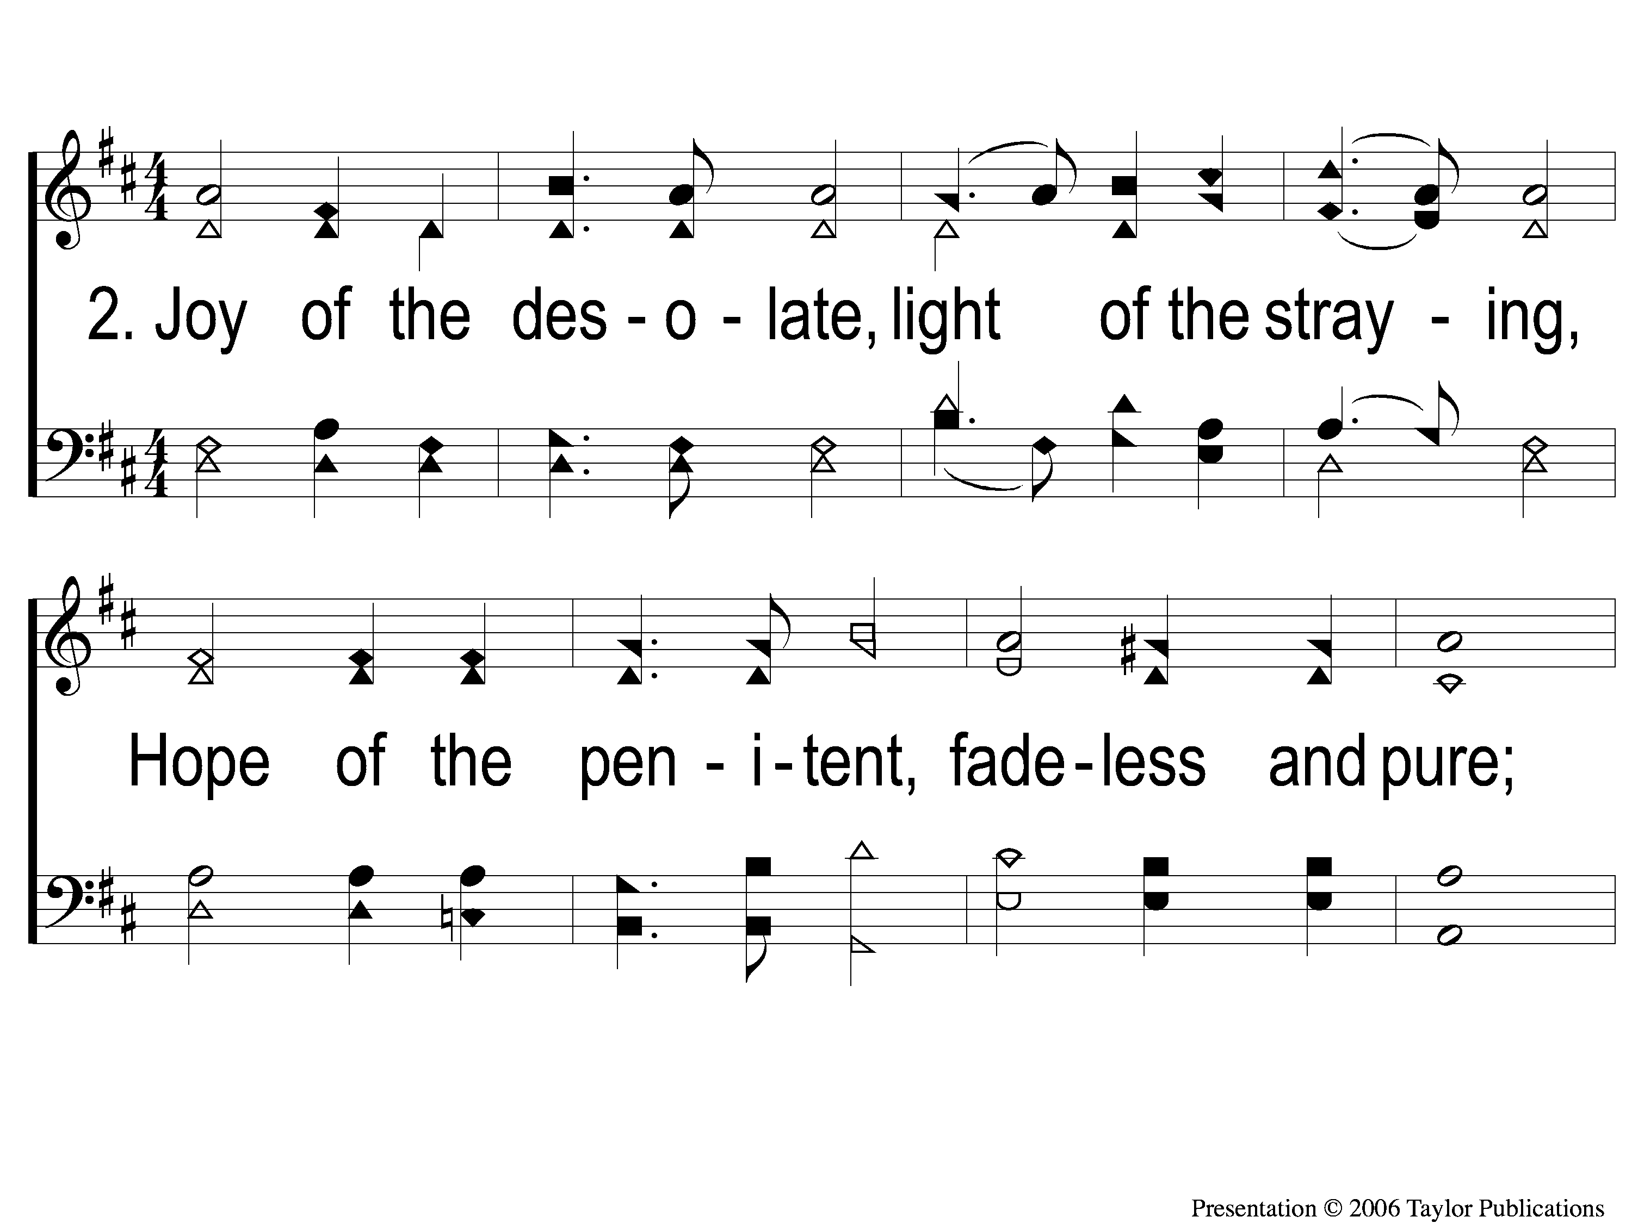
2-1 Come Ye Disconsolate
Come, Ye Disconsolate
61

Slide 4
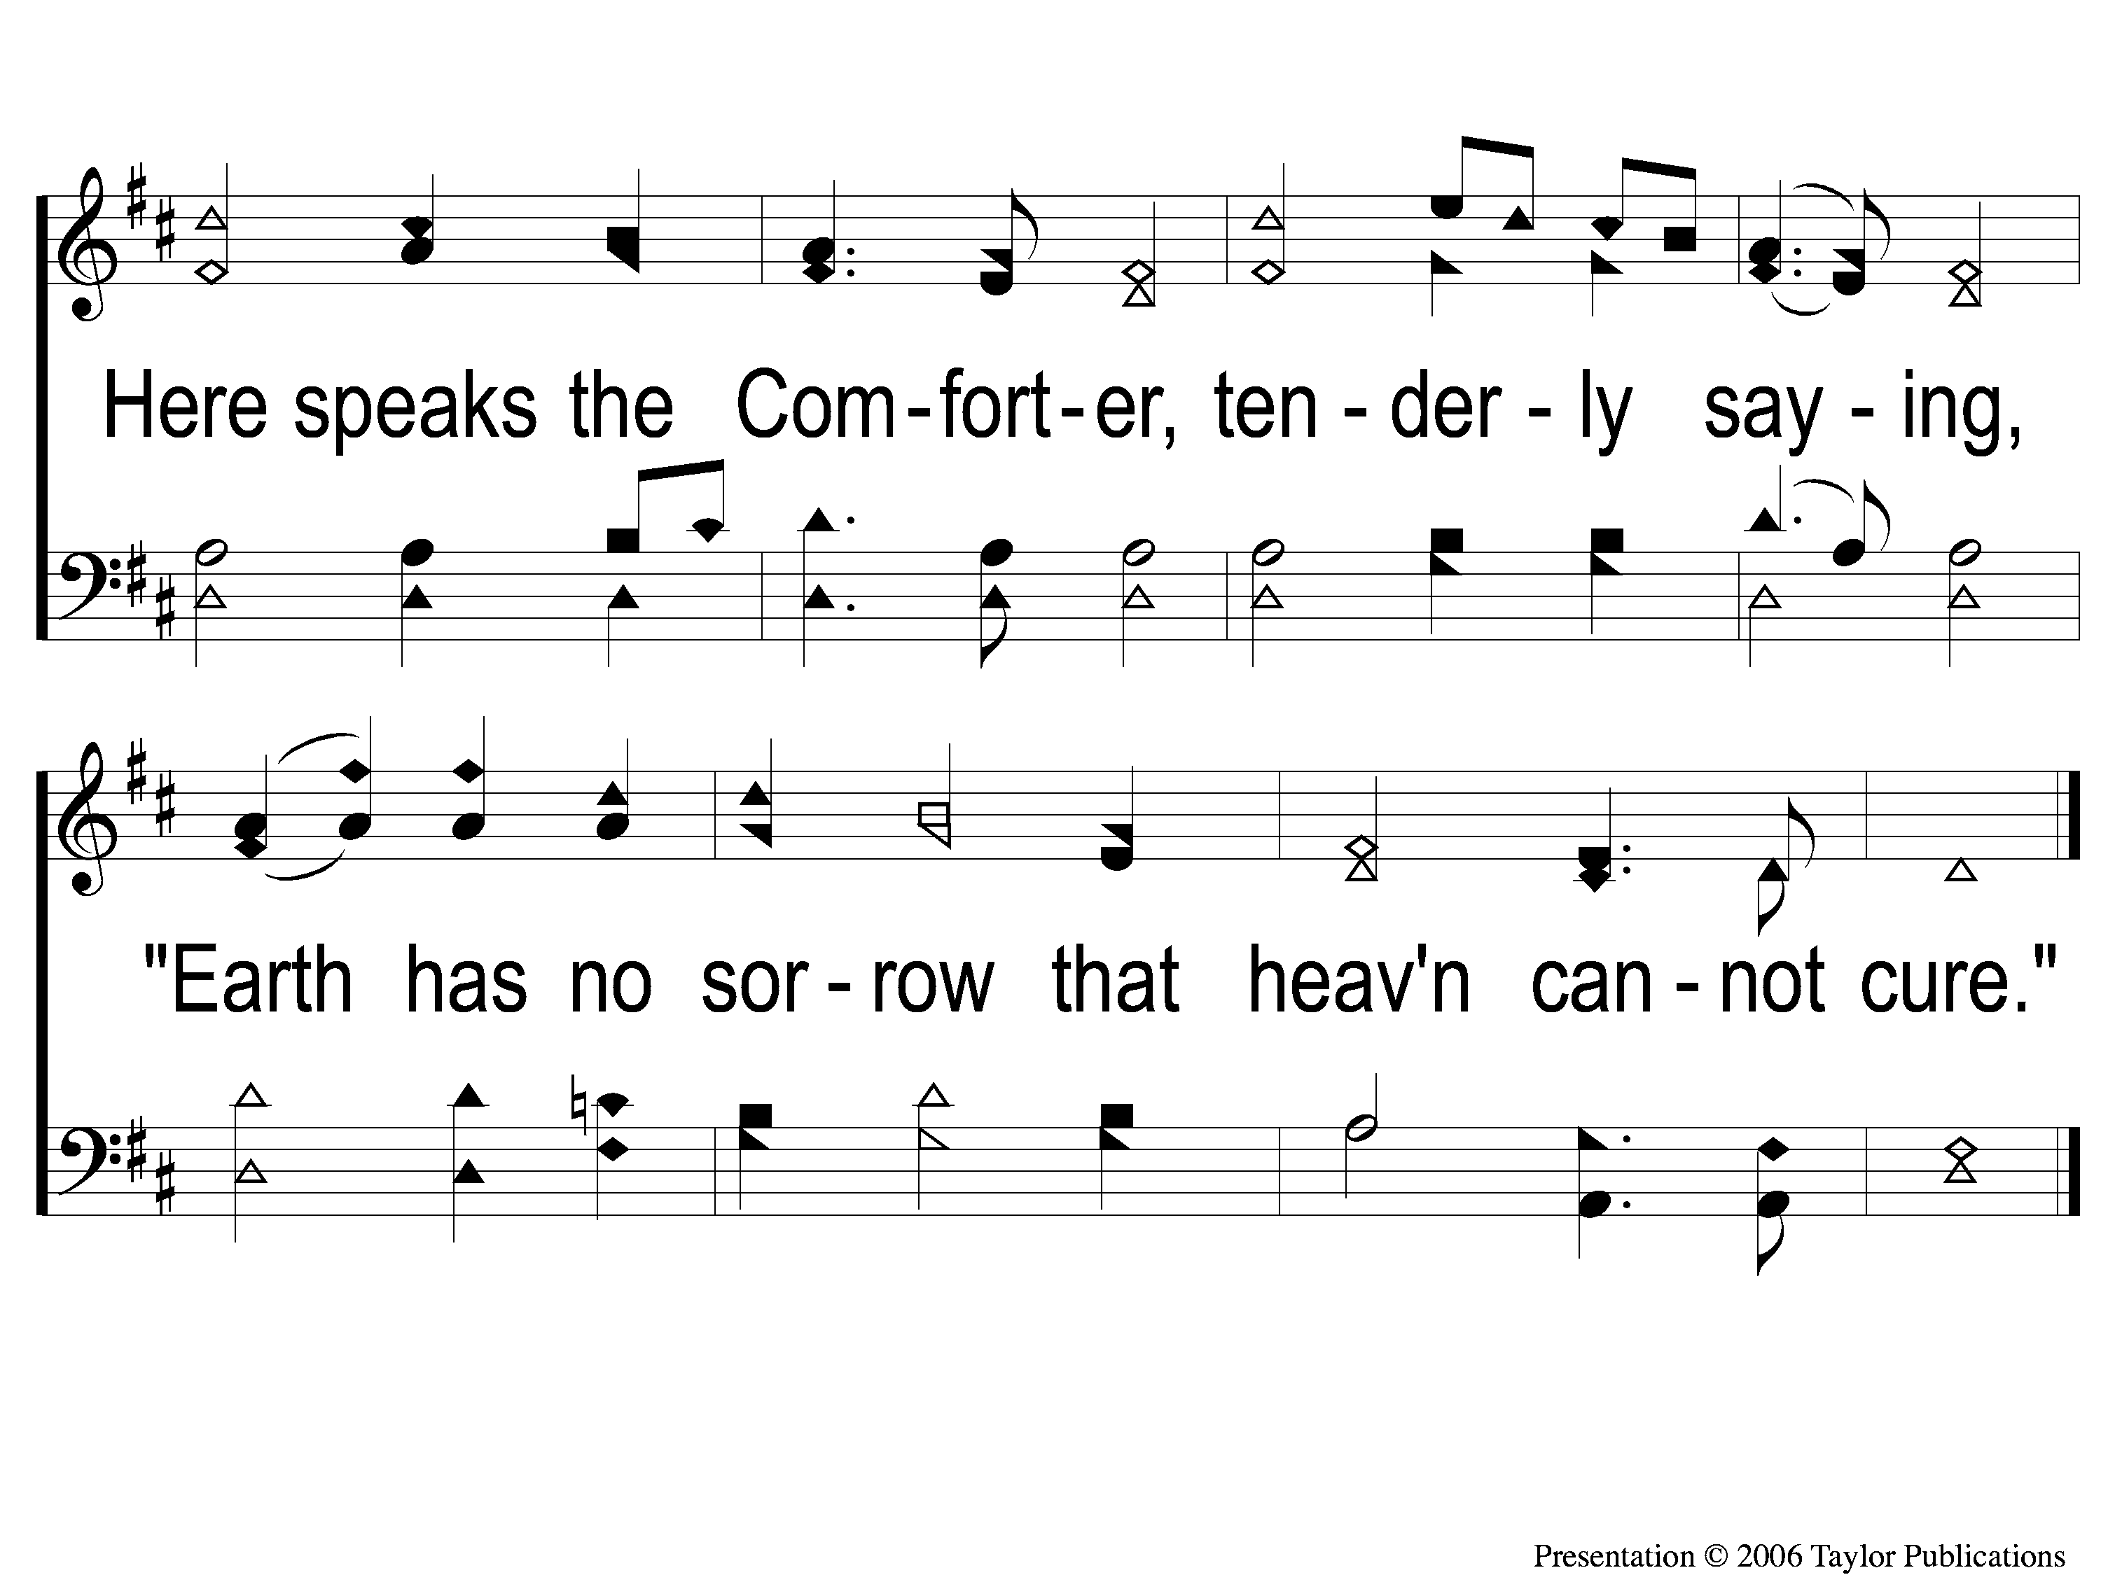
2-2 Come Ye Disconsolate
Come, Ye Disconsolate
61

Slide 5
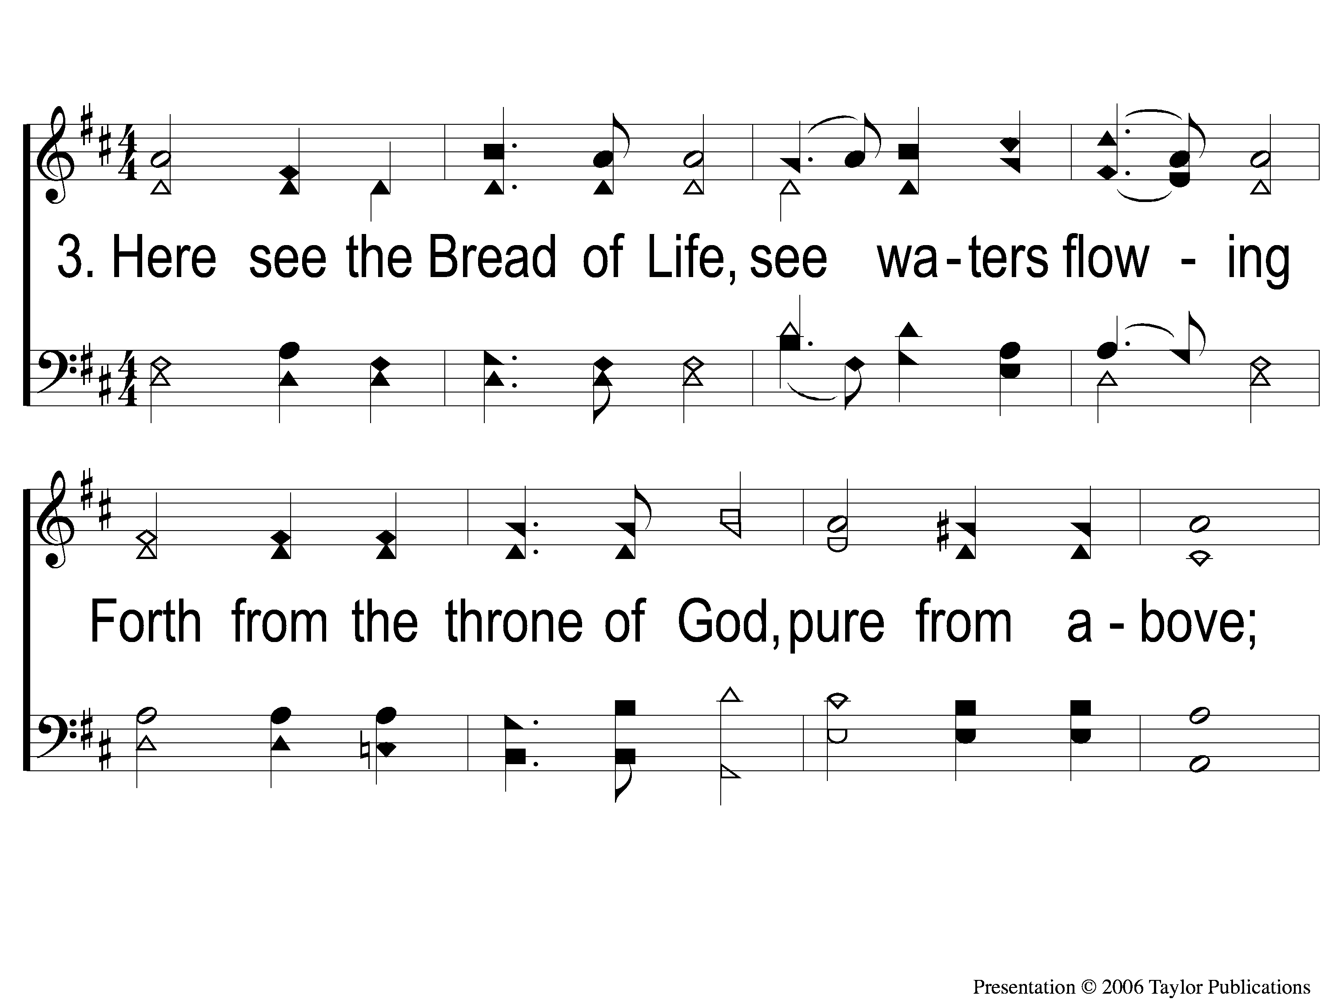
3-1 Come Ye Disconsolate
Come, Ye Disconsolate
61

Slide 6
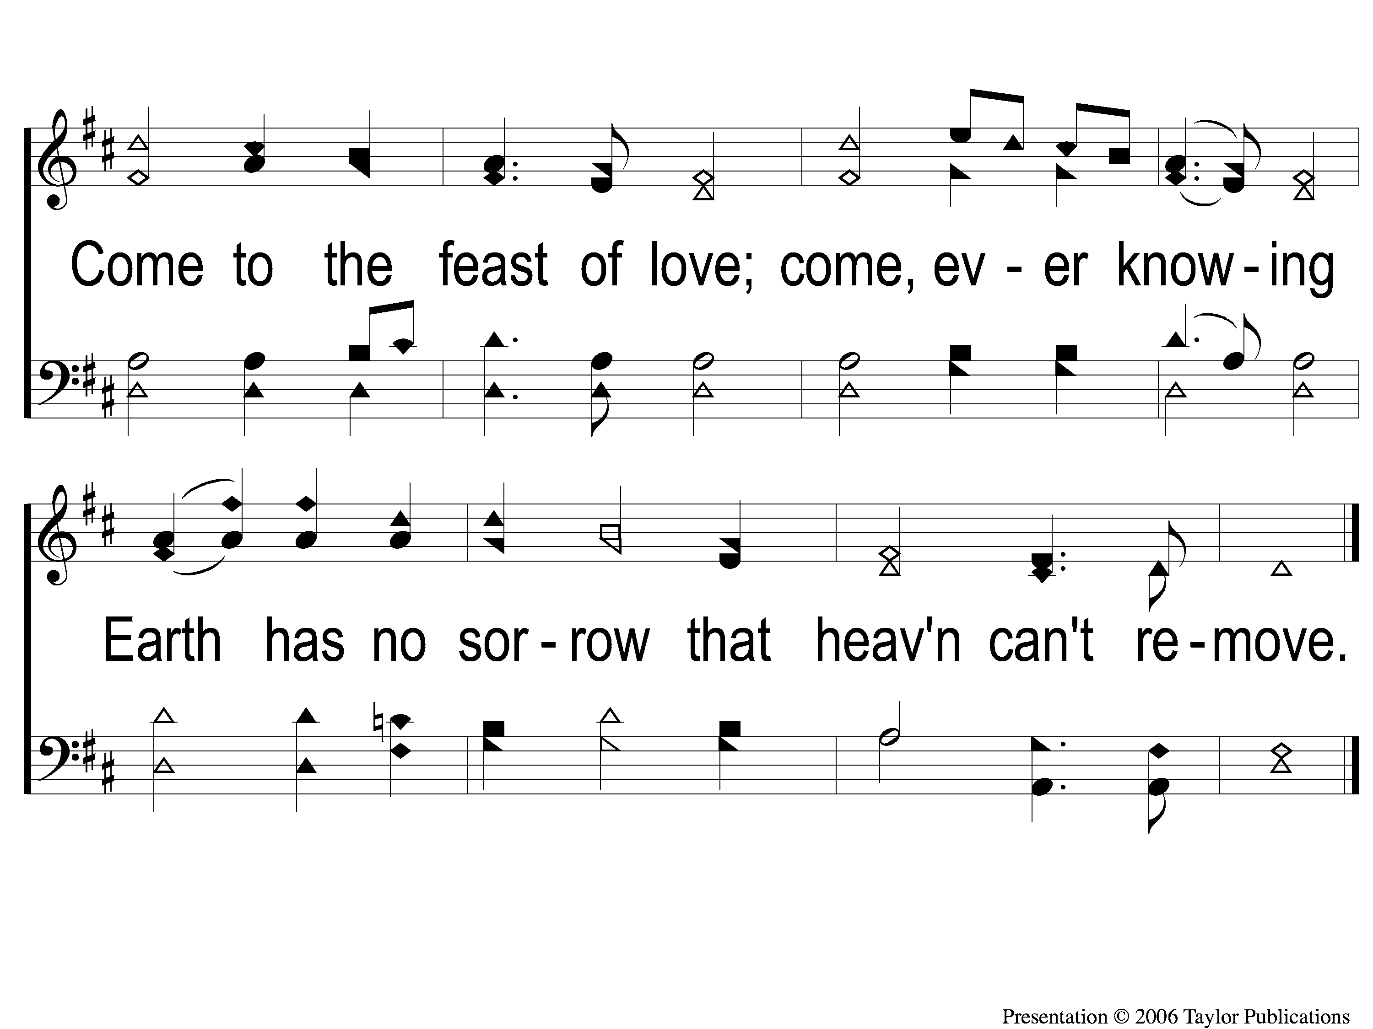
3-3 Come Ye Disconsolate
Come, Ye Disconsolate
61

